Slide 1

FMCG Sales Analysis Dashboard
Created By: DA-P129-FMCG- Project group-1
Group members
Ms. Nikita kishanaapa vaidya
Ms. Rutuja abhay pokale
Mr. Vishal vishnu korgaonkar
Mr. Manish budhiram varma
Ms.Riya karode
Mr. Gourish S rawal
Mentor:
Mahendra Singh
Co-mentor:
Arun Math

Slide 2
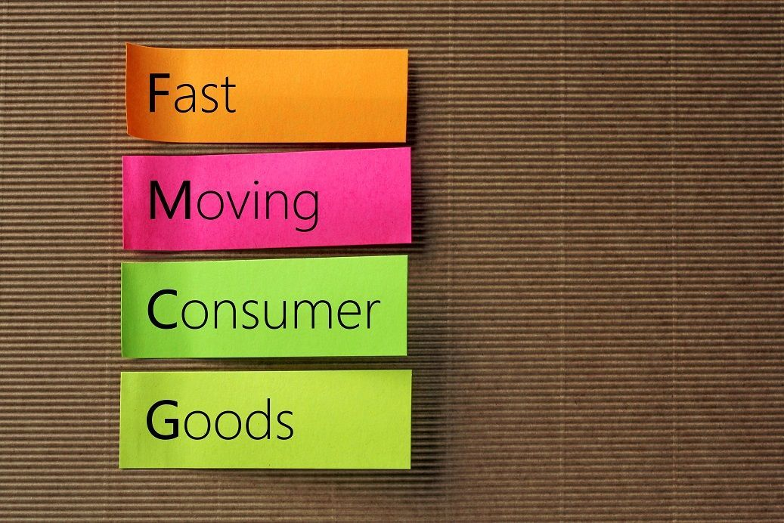
Key KPI’s
Total Sales
Store Wise Sales
Sales Growth
Daily Sales Trend
Brand Wise Sales
AM wise Sales
Sales Vs Budget
Model Wise Sales
Sales Comparison
Product Wise Sales

Slide 3
Introduction
The Food and Beverages Industry comprises a complex network of activities related to the supply, consumption, and catering of food products and services. It plays a significant role in the economic development of any nation. It is one of the world’s most dynamic economic sectors. This Project provides a great Analysis to food and Beverages industry.

Slide 4

Our Task
In this project we have been provided with Food & Beverages dataset (1 CSV files). There are around 237K+ records.
In this project we used tools like MS Excel, MySQL, Tableau & Microsoft Power BI for analyzing given data & finding out important/key insight which will help Management or client to have wiser view and be able to take decisions quickly and accurately.

Slide 5
01
Excel Dashboard

Slide 6
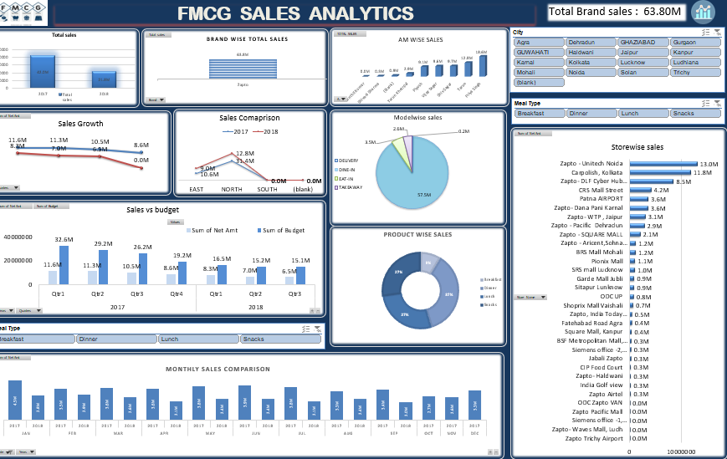

Slide 7
02
Tableau Dashboard

Slide 8
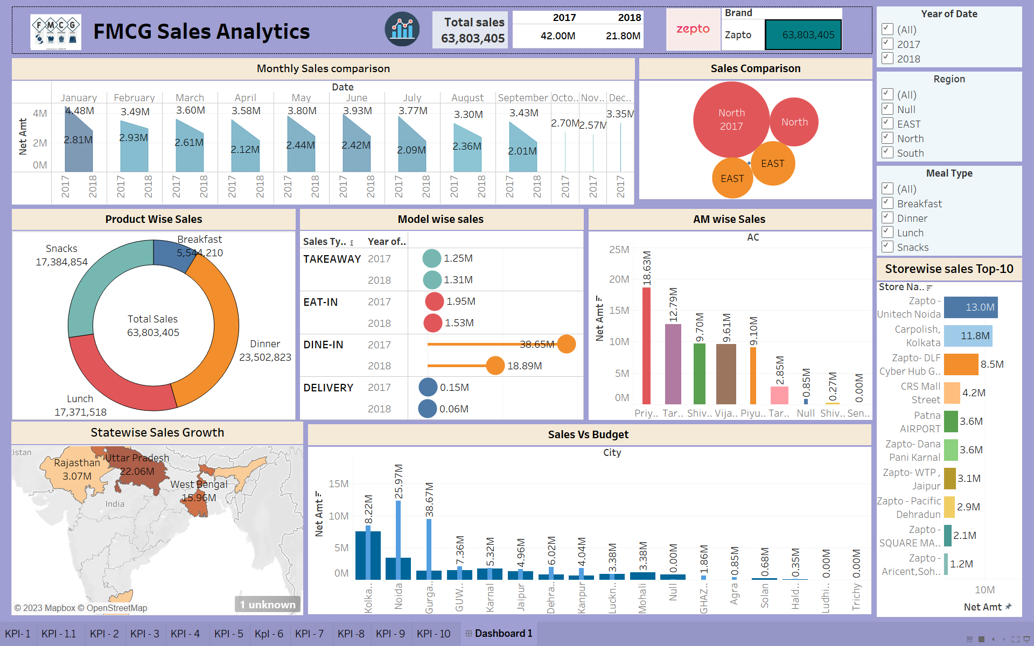

Slide 9
03
Power BI Dashboard

Slide 10
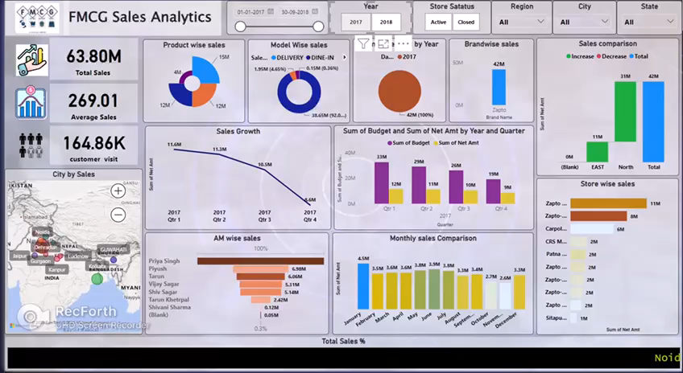

Slide 11
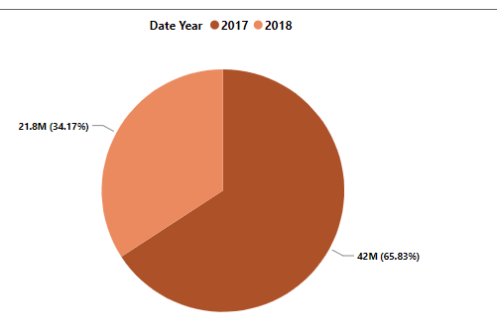
Sales By year
2017
2018
42.00M
21.80M
Sales by year refers to the total revenue generated by a company over a specific time period, usually 12 months. This analysis provides a high-level view of a company's sales performance over time, allowing managers to track trends, identify growth opportunities, and make informed decisions about future investments.

Slide 12
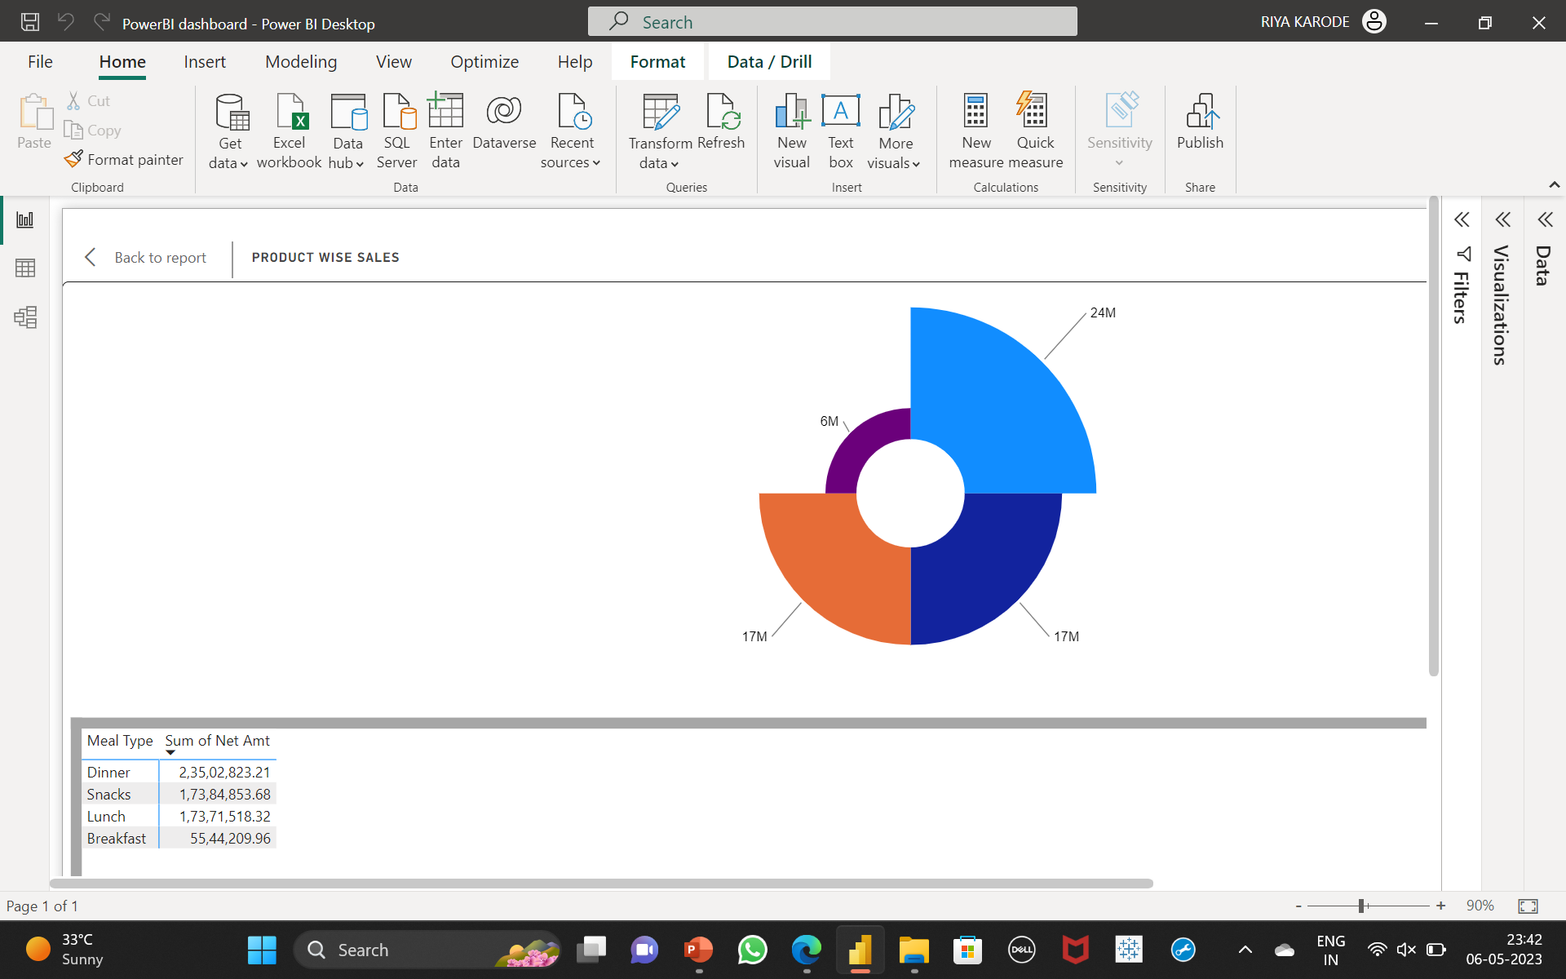
Product wise sales
The graph used donut chart here.
Dinner has the maximum contribution with 24M of the rest followed by Snacks and lunch.
Breakfast has most least contribution with 6M.

Slide 13
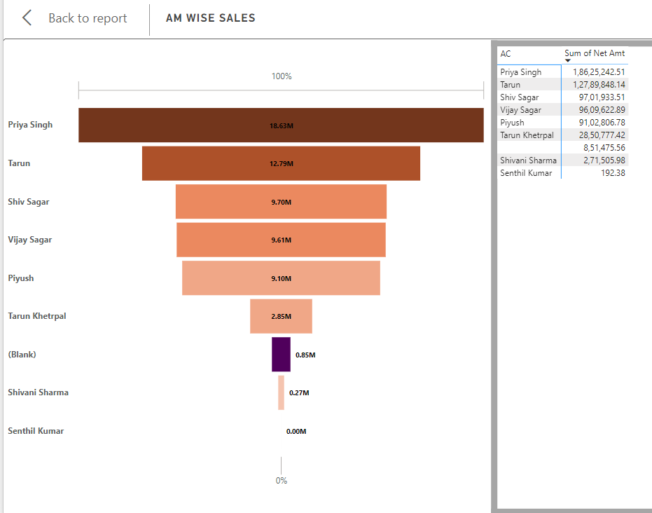
AM wise sales
The funnel chart represents AM wise sales.
There are 8 AM representing the company in which Priya Singh has highest contribution with 18.63 M.
Minimum Sales are done by Shivani Sharma with net sales of 0.27 M.

Slide 14
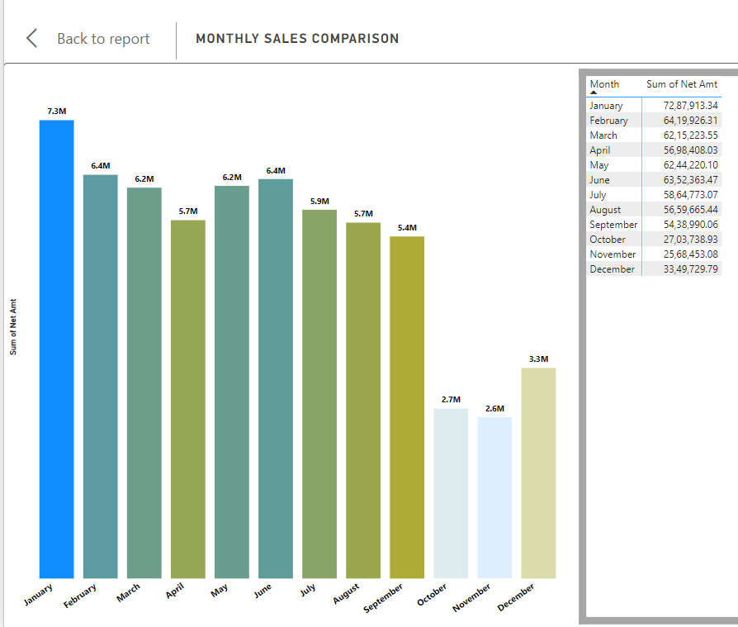
Monthly sales comparison
This graph shows daily sales trend i.e. for each year month-wise sales.
The maximum net worth made by Zapto was in January of the year 2017 after 2018 there was a drop in sales growth which ends on 2.01 M in September of year 2018.

Slide 15
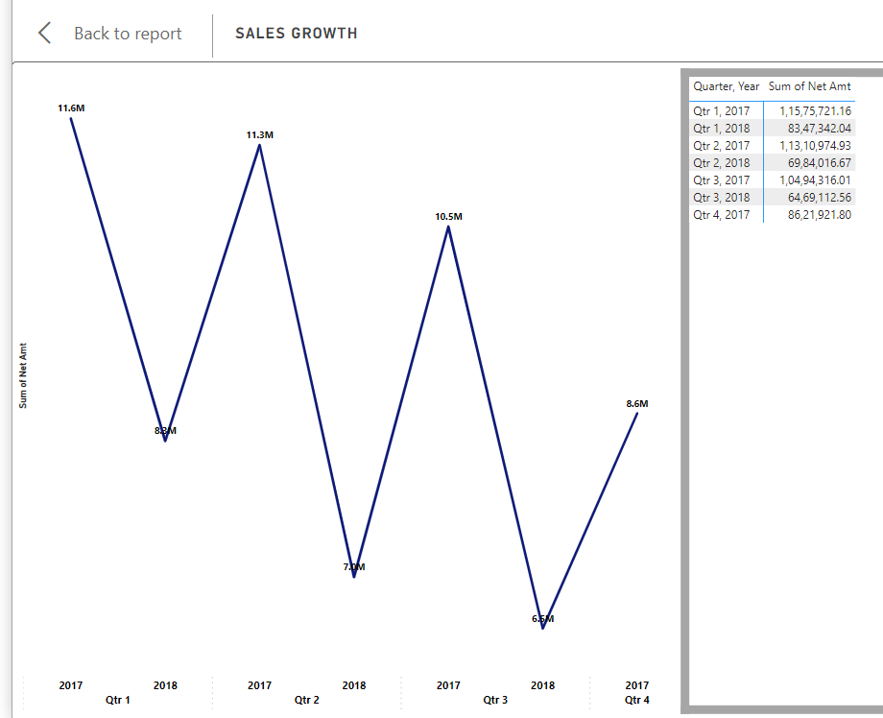
Sales Growth
The graph shown here is year-wise sales growth.
The maximum sales were done in 2017 (Q1,Q2, Q3) and the minimum sales took place in the year 2018 with a Net amt of 11.58 M. The graph shows a drastic drop of sales after year 2017.

Slide 16
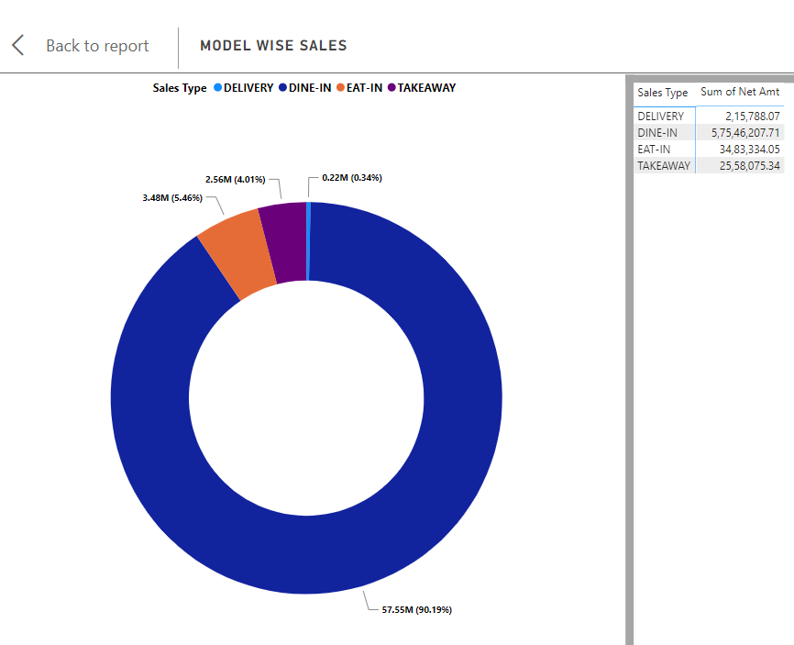
Model wise sales
To represent Model wise sales a Donut chart is used below.
Dine-in has Maximum sales through years which totals 57.55 M where as Delivery has minimum sales just upto 0.22 M.

Slide 17
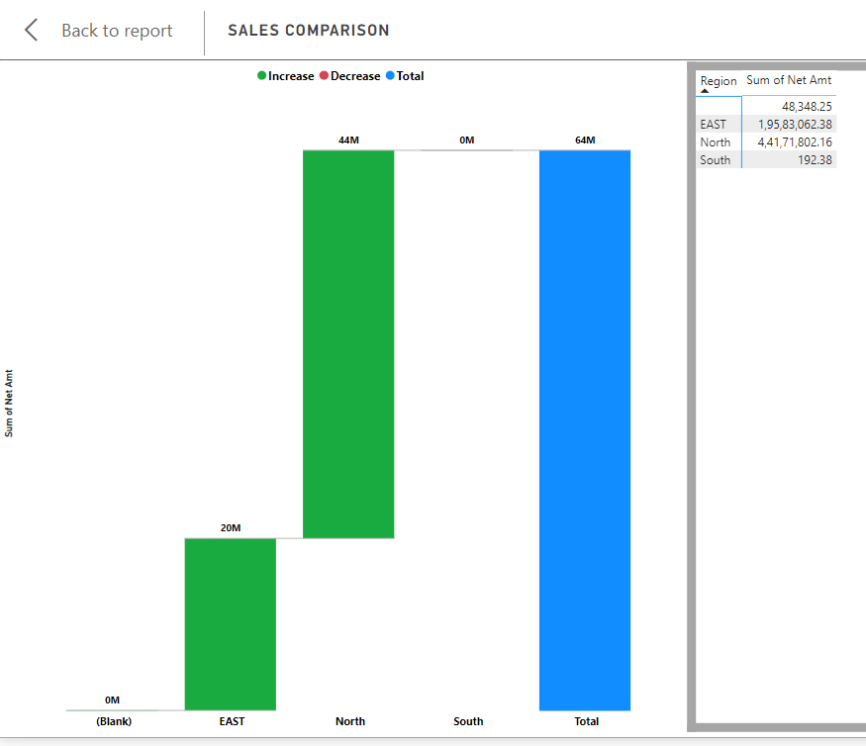
Sales comparison
This Chart shows sales comparison with respect to years and region.
In 2017 and 2018 east and north region had maximum sales while the south did the minimum of 192.38 in years.

Slide 18
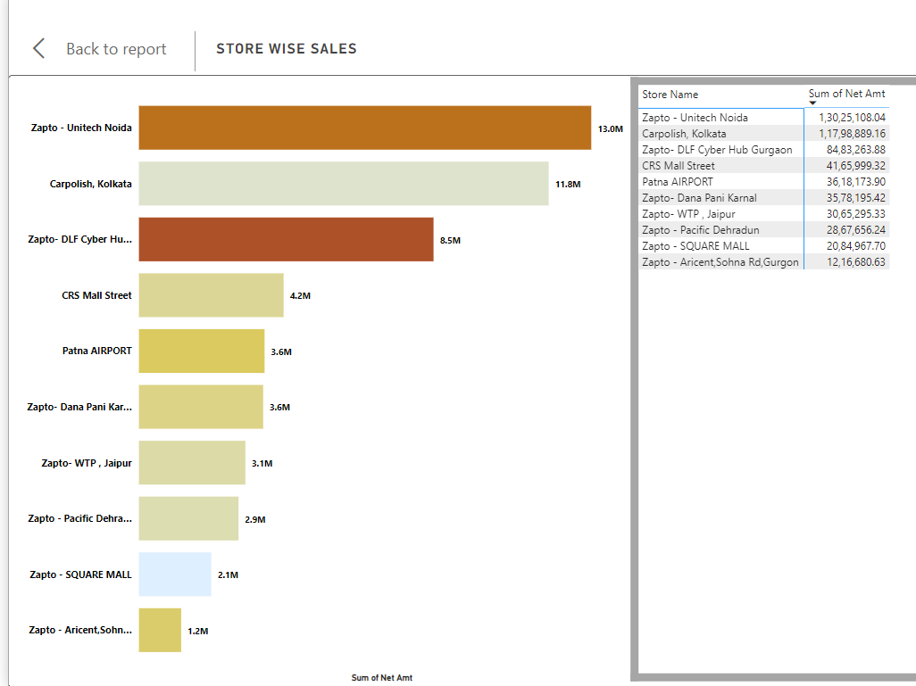
Store wise sales – Top 10
Bar graph shows Store wise sales.
The Highest Sales are done by the Zapto Unitech Noida store whereas the lowest is done by Top-10 is Zapto Aricent,sohna Rd ,Gurgaon Store.

Slide 19
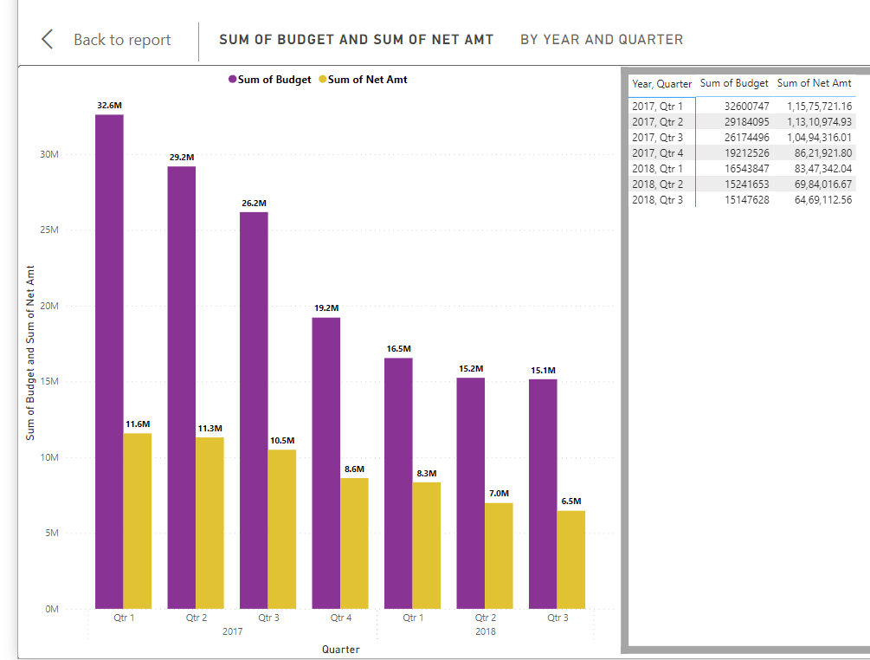
Sales Vs Budget
This analysis helps organizations to evaluate their financial performance by identifying the variance between the actual sales and the budgeted sales.
A positive variance indicates that actual sales have exceeded the budgeted sales, while a negative variance indicates that actual sales have fallen short of the budgeted sales.

Slide 20
BALANCE SHEET
Zapto
Average sales
63.80M
63.80M
260.01
Total Sales
Brand wise Sales

Slide 21
Conclusion
The FMCG dashboard report project created in Power Tableau and Excel is a powerful tool for analyzing key performance indicators and making data-driven decisions in the fast-moving consumer goods industry. The report provides a comprehensive overview of sales, inventory, and profitability metrics across multiple product categories and regions.
This can help companies to optimize their operations, improve their product mix, and increase their profitability.
Overall, the FMCG dashboard report project demonstrates the value of using data analytics tools to gain insights into business performance and make informed decisions. It highlights the importance of collecting and analyzing data in real-time, and the power of visualizations and dashboards to communicate complex information in a clear and concise manner.

Slide 22
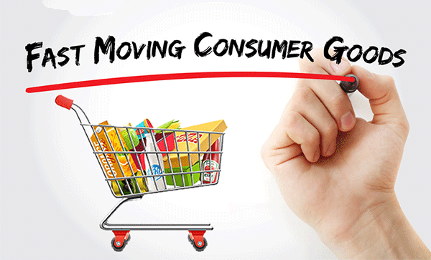
F
M
C
G
THANKS!

